Slide 1
Lesson 3.13
Incident Management Systems (IMS)
CGPRT(W) : Ensuring Clean Seas and Coasts in Western Region ……

Slide 2
Objective
To understand the requirements for efficient management structures.
To understand the benefits and disadvantages of the various management structures.
CGPRT(W) : Ensuring Clean Seas and Coasts in Western Region ……

Slide 3
IMS
Oil spills are sudden, unexpected and rapidly evolving situations.
Regardless of the size and complexity, multiple resources will be required
    Governmental agencies
    Technical experts
    Equipment
    Communications
It is essential to coordinate these multiple resources.
CGPRT(W) : Ensuring Clean Seas and Coasts in Western Region ……

Slide 4
IMS
An Incident Management System (IMS) is essential for an effective response
  Ensure that all essential functions of a response are taken care of
  Ensure control of response actions
  Ensure coordination of resources
  Ensure the development of incident action plan
CGPRT(W) : Ensuring Clean Seas and Coasts in Western Region ……

Slide 5
IMS
Incident action plan
  Provides clear instructions to response personnel
  Describes the activities and logistical support necessary for response
    Incident objectives
    Strategies
    Tactics
  Covers a specific time period (24 hours, 7 days)
  Updated throughout the response as situation and strategies change
CGPRT(W) : Ensuring Clean Seas and Coasts in Western Region ……

Slide 6
IMS
Incident action plan
  Typically includes the following sections
    Situation
      Area affected, sensitivities, actions taken
    Objectives
      What is the response trying to achieve?
    Operations
      Strategies and tactics
      Deadline for completion
    Administration and logistics
      Describes elements required to support response
    Reporting arrangements
CGPRT(W) : Ensuring Clean Seas and Coasts in Western Region ……

Slide 7
IMS
Example of incident action plan:
  Objective: Prevent oiling of area X
  Strategy: Application of dispersants
  Tactic: Use a fix wing aircraft to apply dispersant at location Y
  Logistics: C130 aircraft, 10,000 litres of dispersants, support aircraft for coordination, 5 staff at refuelling bay
  Reporting: Head of operations to be informed of mission results
CGPRT(W) : Ensuring Clean Seas and Coasts in Western Region ……

Slide 8
IMS
Important characteristics of IMS:
  Must be flexible
  Must be scalable
  Ensure command, control and coordination of efforts
  Is manageable (span of control)
  Multiple agencies and stakeholders are integrated in structure according to their function
CGPRT(W) : Ensuring Clean Seas and Coasts in Western Region ……

Slide 9
IMS
Key functions of IMS
  Command
    Management/coordination of the overall response
  Planning
    Planning of future operations based on knowledge of situation
  Operations
    Conduct operations
  Logistics
    Providing logistical support
  Finances
    Financial control and record keeping
CGPRT(W) : Ensuring Clean Seas and Coasts in Western Region ……

Slide 10
IMS
Incident Commander
Advisor
Planning
Operations
Logistics
Finances
CGPRT(W) : Ensuring Clean Seas and Coasts in Western Region ……

Slide 11
IMS
Command function
  Responsible for overall management
  Sets objectives and priorities
  Establishes an appropriate organization
  Ensures planning meetings are scheduled
  Approves and authorizes the implementation of an Incident Action Plan
  Ensures that adequate safety measures are in place
  Coordinates with key people and officials
CGPRT(W) : Ensuring Clean Seas and Coasts in Western Region ……

Slide 12
IMS
Command function
  Approves requests for additional resources or for the release of resources
  Authorizes release of information to the news media
  Orders the demobilization of the incident when appropriate
  Can be one individual or a group
    Legal and communication advisors
CGPRT(W) : Ensuring Clean Seas and Coasts in Western Region ……

Slide 13
IMS
Planning function
  Evaluation of situation
    Weather, oil trajectory, oil weathering
  Environment
    Sensitive resources, acceptable methods, wastes, end-points
  Develop response strategies
    Identify best response strategies based on situation and environmental sensitivities
CGPRT(W) : Ensuring Clean Seas and Coasts in Western Region ……

Slide 14
Planning Function
Planning function
Situation/Intelligence
Environment
Response planning
Resource deployment
Technical support
CGPRT(W) : Ensuring Clean Seas and Coasts in Western Region ……

Slide 15
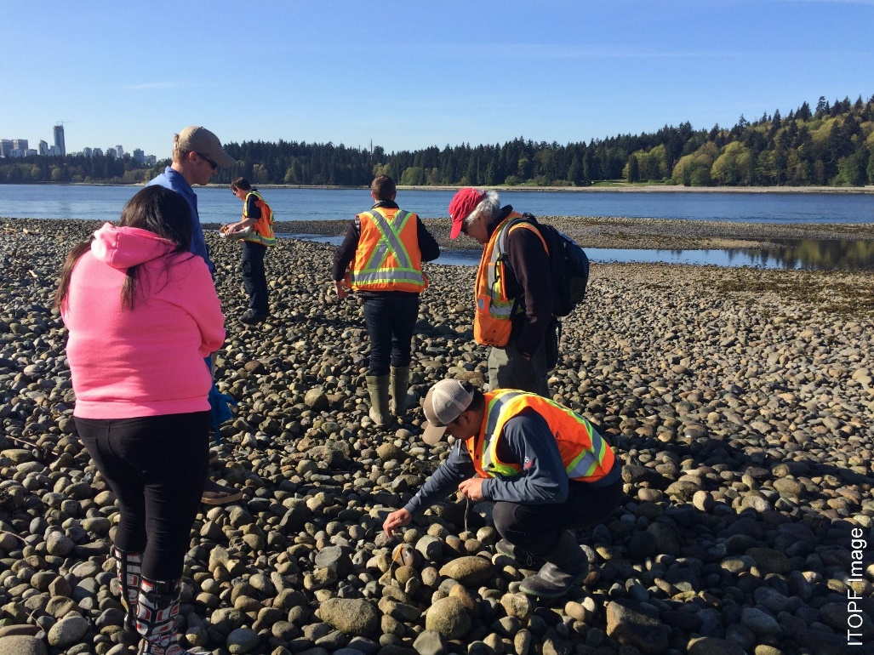
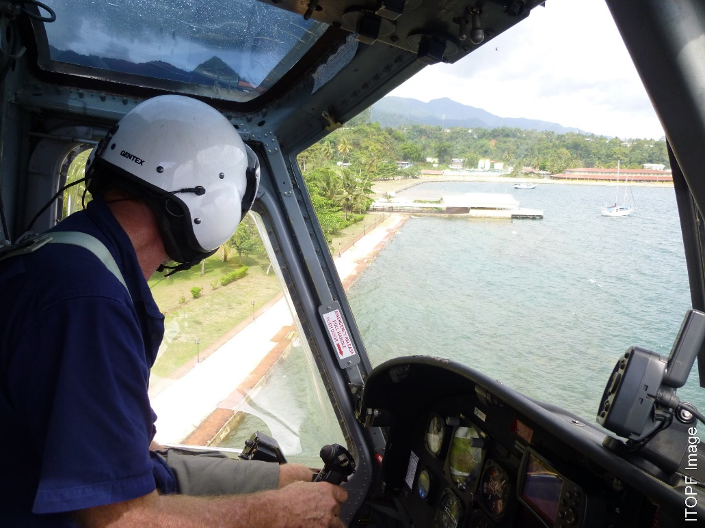
IMS − Planning
CGPRT(W) : Ensuring Clean Seas and Coasts in Western Region ……

Slide 16
IMS
Operations function
  Implement response action plan
    Deployment of resources (people and equipment)
  Management and coordination of response operations
    Marine operations
    Shoreline operations
    Aerial operations
    Wildlife response
    Health and safety
CGPRT(W) : Ensuring Clean Seas and Coasts in Western Region ……

Slide 17
IMS
Operations function
  Operations can take place at multiple locations depending on scale of incident
  Operations might be divided in multiple divisions and sub-divisions depending on requirements of incident.
CGPRT(W) : Ensuring Clean Seas and Coasts in Western Region ……

Slide 18
Operations Function
Operations Function
Aviation Division
Health & Safety
Waste Management
Shoreline Division
Wildlife Division
Marine Division
Aerial Dispersants
Aerial Surveillance
Marine Containment & Recovery
Marine Dispersants
Sector A
Sector B
Response Team B
Response Team A
Response Team A
Response Team B
A typical layout: Must be adjusted to fit your incident
CGPRT(W) : Ensuring Clean Seas and Coasts in Western Region ……

Slide 19
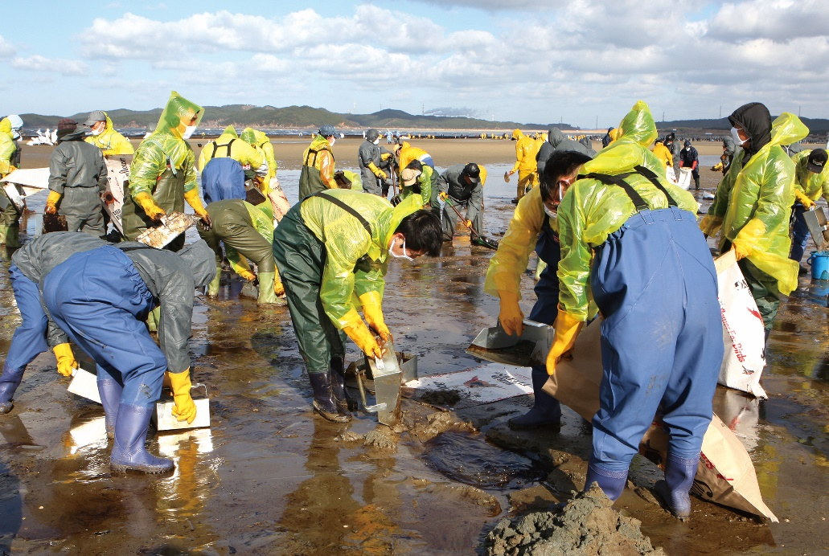
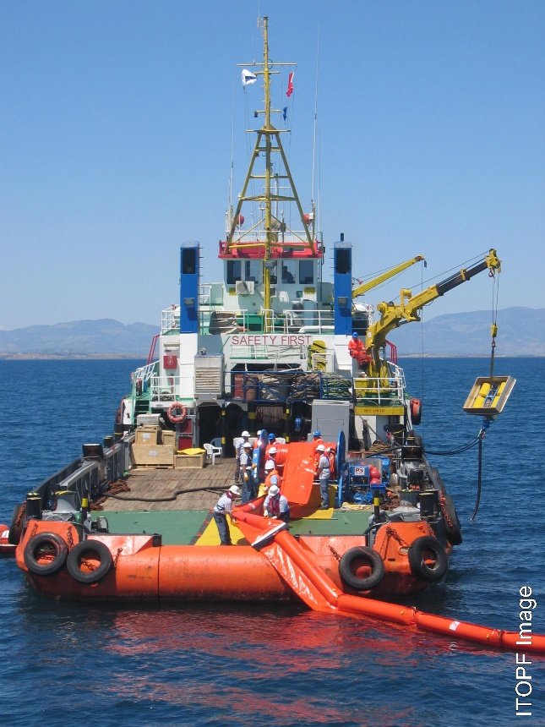
IMS − Operations
CGPRT(W) : Ensuring Clean Seas and Coasts in Western Region ……

Slide 20
IMS
Logistics function
  Supports operations by providing and maintaining resources and services necessary for the response
    Communication
    Equipment and personnel
    Transport and fuel
    Lodging
    Food and water
    Toilets
    Etc.
  Ensures delivery and storage of supplies
CGPRT(W) : Ensuring Clean Seas and Coasts in Western Region ……

Slide 21
Logistics Function
Logistics function
Supply
Communications support
Facilities support
Transport support
Subsistence
CGPRT(W) : Ensuring Clean Seas and Coasts in Western Region ……

Slide 22
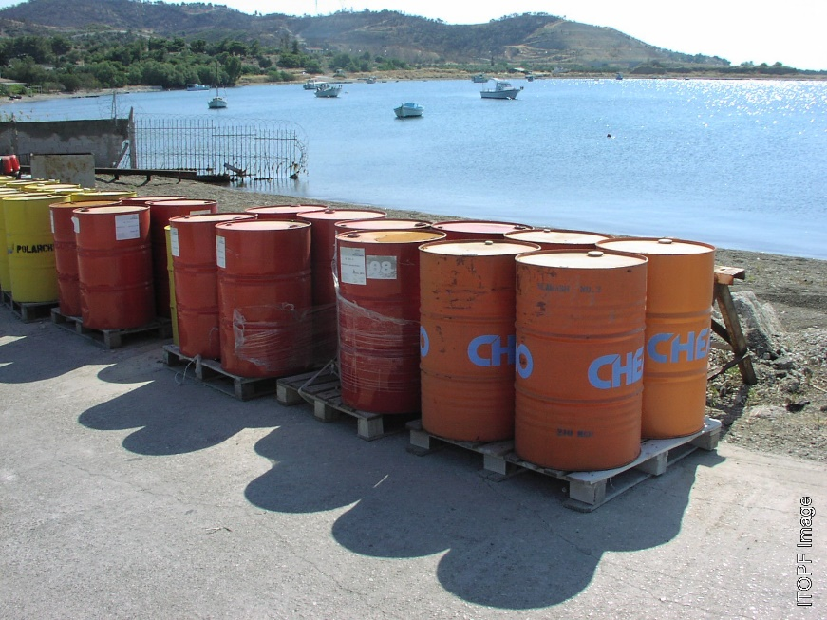
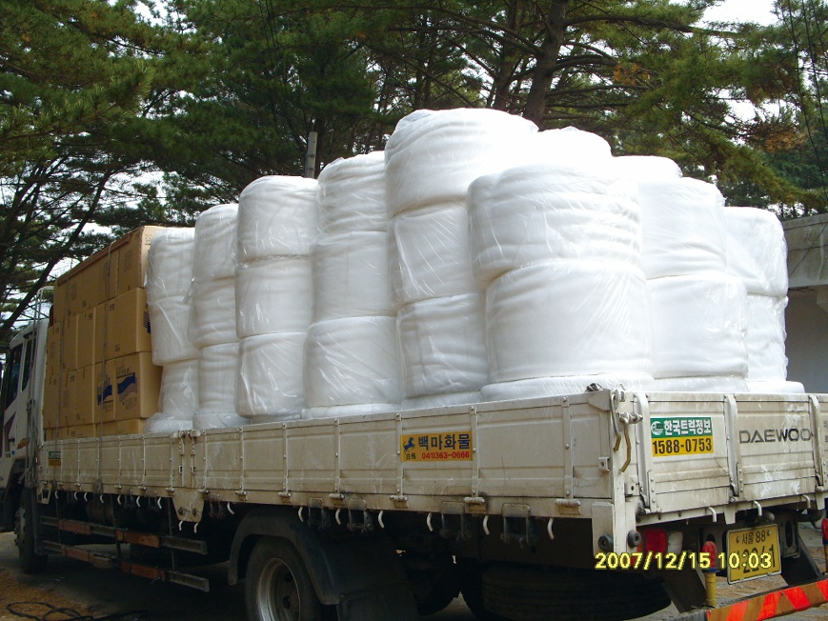
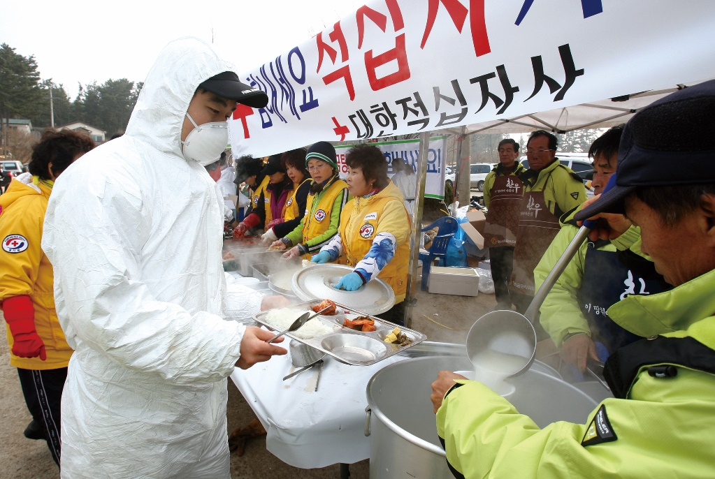
IMS − Logistics
CGPRT(W) : Ensuring Clean Seas and Coasts in Western Region ……

Slide 23
IMS
Finance function
  Manages financial and administrative aspects of response
    Monitors and maintains records on costs incurred
    Responsible for human resources
    Makes payments to staff, contractors, suppliers
  Compiles and prepares claims for costs recovery
    To insurers
    To IOPC Fund
CGPRT(W) : Ensuring Clean Seas and Coasts in Western Region ……

Slide 24
IMS
Finances
Accounts
Insurance/Compensation
Cost recovery
CGPRT(W) : Ensuring Clean Seas and Coasts in Western Region ……

Slide 25
IMS
Who does it? – some examples
  Command
    Designated national authority
  Planning
    Weather services, environment, technical experts, fisheries, etc.
  Operations
    Navy, air force, coast guards, civil defense, etc.
  Logistics
    Coast guard, Min. of Equipment, etc.
  Finances
    Min. of Finance, coast guards
Will be adapted for each country
CGPRT(W) : Ensuring Clean Seas and Coasts in Western Region ……

Slide 26
IMS
Incident command centre
  Physical location of the incident management team
  Integrates all agencies and responders at one location
  Basic requirements:
    Communication systems (internet, phones, etc.)
    Work area
    Security and controlled access
    Away from hazards
    Ability to expand and adapt to incident
CGPRT(W) : Ensuring Clean Seas and Coasts in Western Region ……

Slide 27
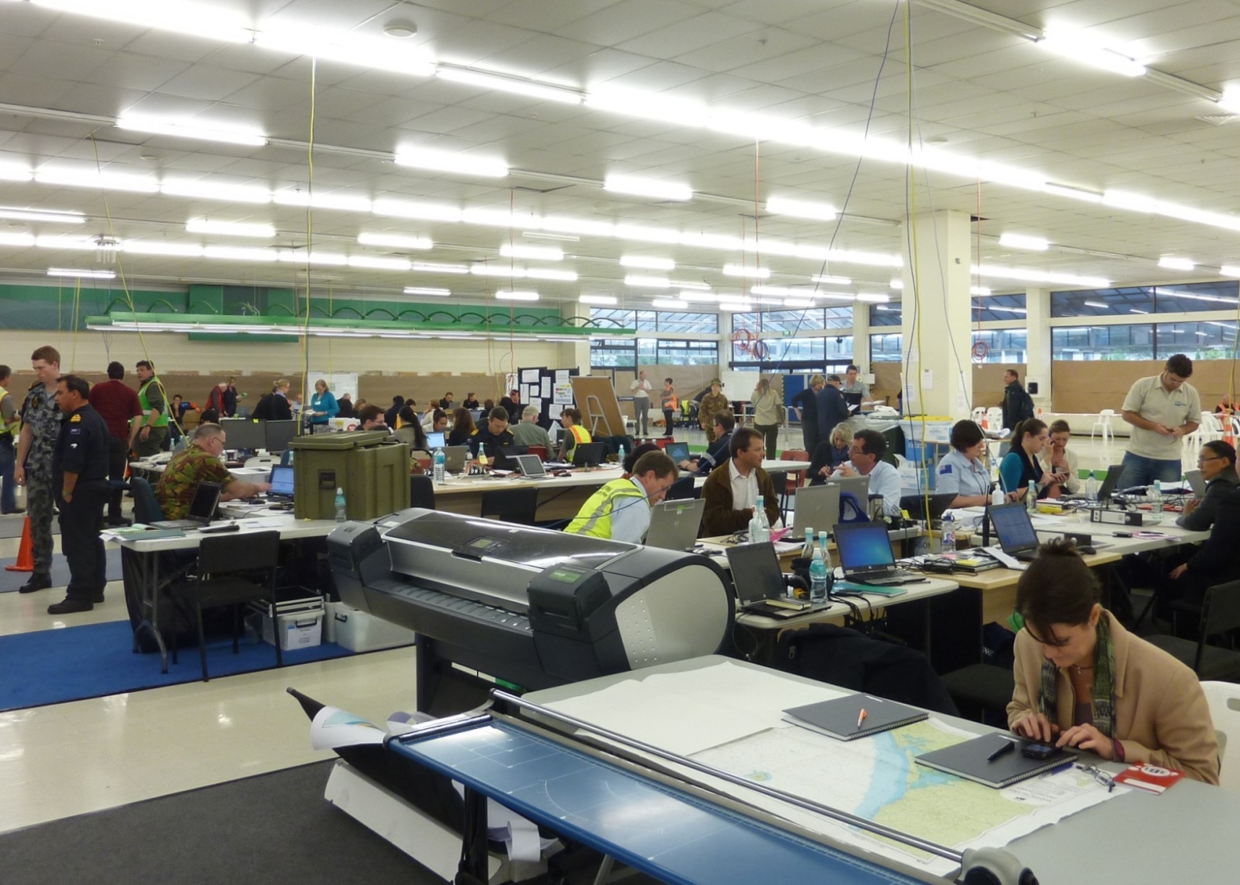
Incident Command Centre
CGPRT(W) : Ensuring Clean Seas and Coasts in Western Region ……

Slide 28
Conclusion
It is very difficult to manage an oil spill without an incident management system (IMS)
Ensures that all response functions are carried out
Provides a framework for integration and coordination of resources
Facilitates decision-making
  Clear role and responsibilities
Adaptable to your own circumstances
CGPRT(W) : Ensuring Clean Seas and Coasts in Western Region ……

Slide 29
Any questions?
CGPRT(W) : Ensuring Clean Seas and Coasts in Western Region ……

